Slide 1



Classroom Door Access Control and Monitoring System in Campus
A comprehensive solution for modern campus safety challenges.

Slide 2
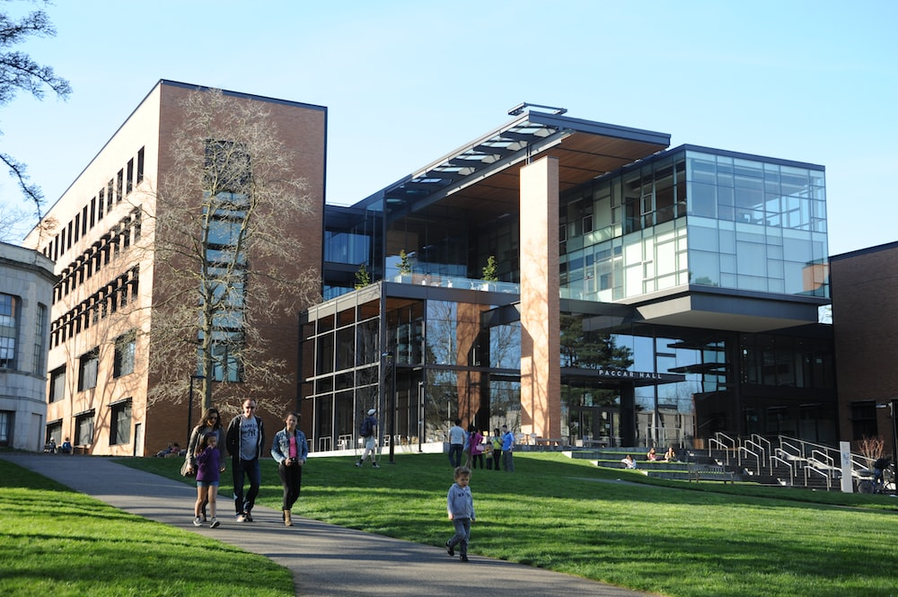

Introduction
Today's college campuses need better security infrastructure to keep up with the growing challenges and evolving threats. In this presentation, we will discuss an integrated approach to utilizing IoT technology to enhance campus security.

Slide 3

The Growing Need for Advanced Security
The landscape of campus security has evolved significantly over the years. Increased instances of violence and theft have made traditional campus safety methods insufficient. Our integrated approach aims to provide enhanced security through modern technology.

Slide 4

Key Challenges Identified
Unauthorized Access
After-Hours Security
Ensuring Doors are Secured
Limiting access to sensitive areas of the campus is crucial to ensuring safety and privacy.
Ensuring campus security measures extend beyond regular class hours is essential.
Keeping doors and gates locked at all times is necessary to prevent unauthorized entry into campus buildings.

Slide 5

Objective and Goals of the Project
1
Improved Security
improve campus overall security.
2
Efficiency and Convenience
increase convenience for security crew
3
Day-time and night-time situation
24 hours protection
RFID access control (Day-time)
Theft prevention (Night-time)
Notes:
The main goal is to create a comprehensive, integrated approach to campus safety that will improve overall security.

Slide 6







Database
Access Control System (Day time)
Buzzer
2. LED
3. RFID
4. Database
5. WIFI
Notes:
Our Access Control system utilizes advanced RFID technology coupled with a buzzer and LED indicators. When a valid card is tapped on the reader, the LED signal changes, granting access to the classroom. The system also records access details for future reference and analysis.

Slide 7
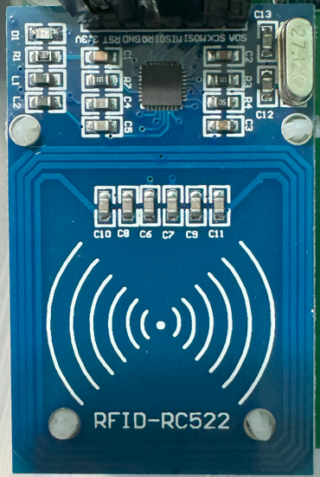



RFID-based Authentication System
An introduction to RFID technology
Benefits for classroom access control
Enhanced security for campus buildings
Notes:
We will be utilizing RFID card as the primary means of authentication for our security system.
RFID tags are convenient for students, teachers and other authorized personnel to access classrooms, labs, and other campus facilities.
RFID authentication helps prevent unauthorized access.

Slide 8

Implementing RFID in Campus
1
RFID Integration
We will install RFID readers at various entry and exit points across campus to provide identity authentication.
2
Connecting to the database
Once we have installed RFID readers, we will connect them with an online Database via WIFI and PHP to perform the authentication
3
User Interaction
The LED light will turn green for a valid authentication. If not, it turns red.

Slide 9
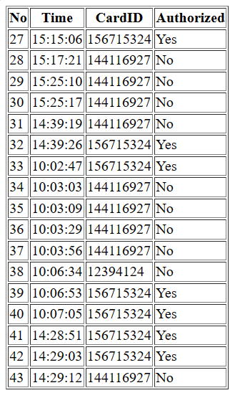
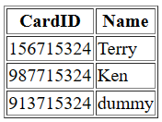
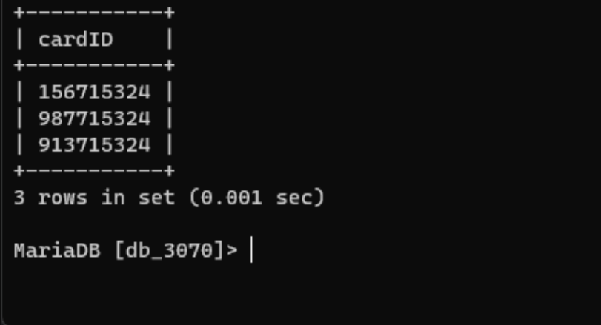
Database Integration
Store all the information of all staff and student
2. Allow security administrator can modify the database thought SQL
3. keep tracking all record in real-time.

Slide 10


Database
Access Control System (Night time)
Buzzer
2. motion sensors
3. door lock sensor
4. Database
5. WIFI
Notes:
During non-operational hours, our Monitoring System ensures the highest level of security. It employs motion sensors and door lock sensor to detect any unauthorized activities. When triggered, the system alerts the appropriate personnel and sends real-time updates to a cloud-based MySQL database via ThingSpeak.

Slide 11
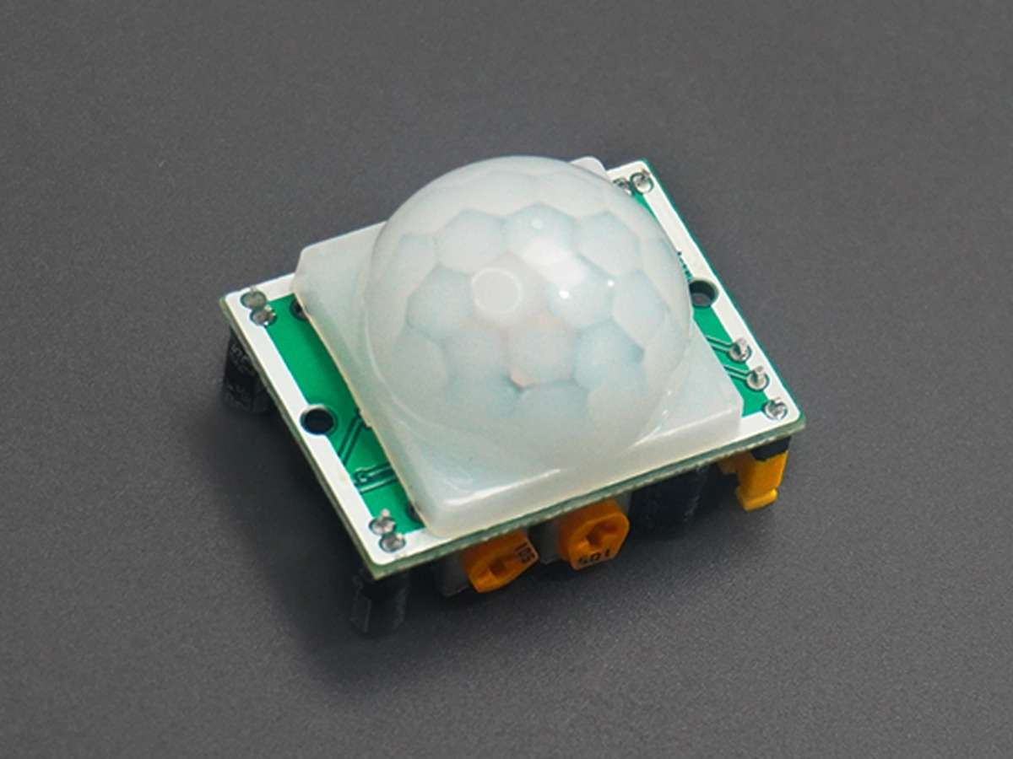
Motion Detection for Enhanced Security
Active Protection
Enhanced Alerts
Motion sensors act as an active protection layer to detect and deter any suspicious activity.
Motion detection enhances the overall security setup and provides alerts to security personnel in any potential threat situations.

Slide 12

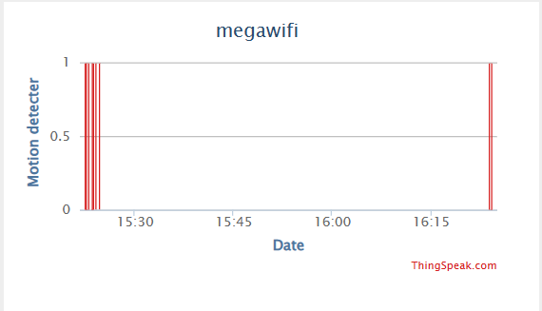
Motion Sensor Integration and Functionality
1
Motion Sensor Setup
We install a network of motion sensors across campus to monitor campus movement.
2
Integration with Security System
The data collected by sensors will be integrated into the ThinkSpeak, providing real-time analysis and detection of any unusual activities.
3
Automated Warning System
Automated warning alerts will be enabled if any suspicious activities are detected.

Slide 13

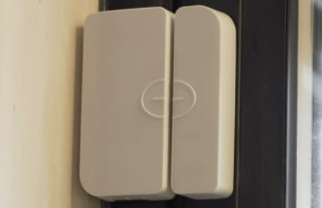
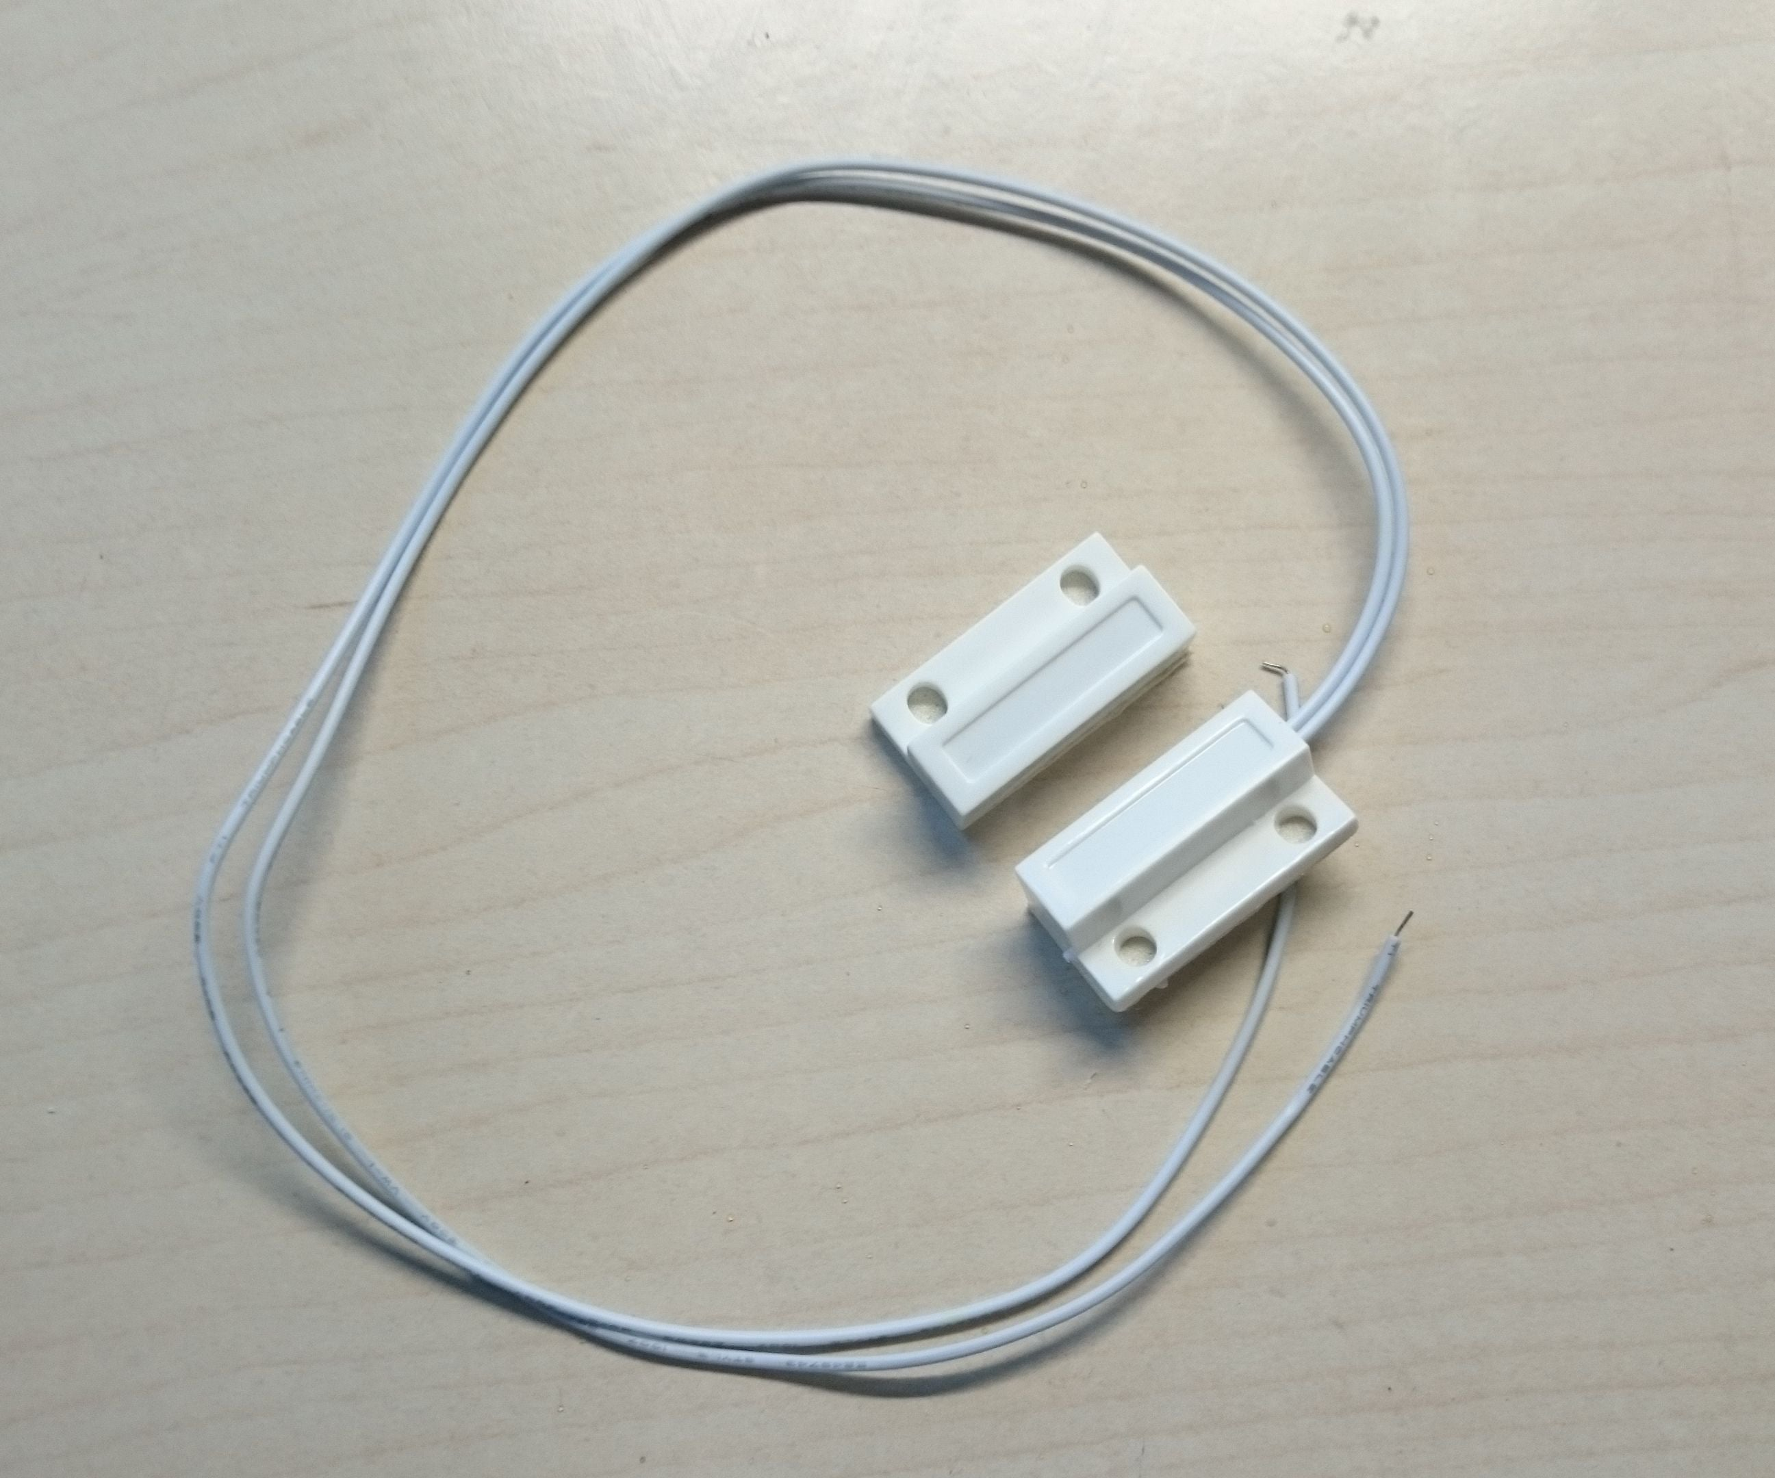
Door Lock Sensors
Importance of ensuring doors are secured
Efficient and Effective Access Control
Campus-Wide Integration
Notes:
Door sensors help ensure that campus buildings remain secure and safe from intrusion.
The door sensors are an efficient and effective means of access control to authorized personnel.
The door sensors will be integrated into the overall security setup to provide a comprehensive and complete approach.

Slide 14

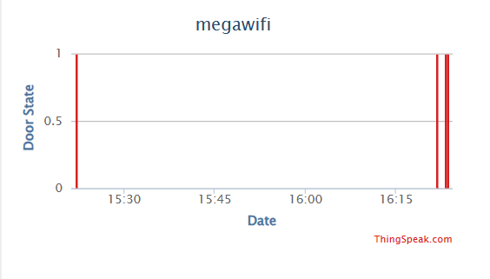
Integration of Door Sensors
1
Door Sensor Setup Across Campus
We install door sensors across all campus buildings.
2
Utilizing the Security Network
The data collected by sensors will be integrated into the ThinkSpeak, providing real-time analysis and detection of any unusual activities.
3
Automated Warning System
Automated warning alerts will be enabled if any suspicious activities are detected.

Slide 15

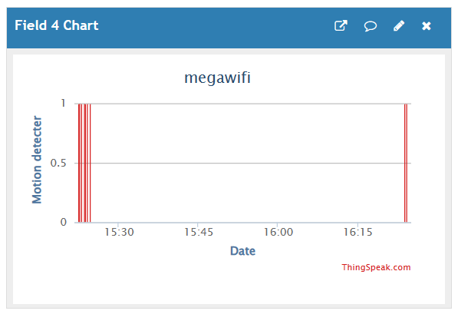
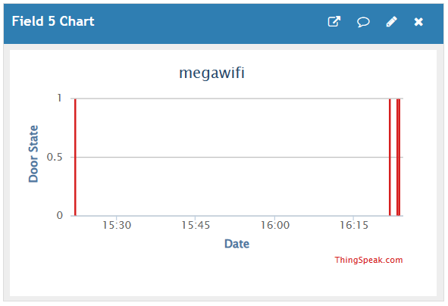
ThingSpeak Integration
Receive signals from motion sensor and door lock sensor
Immediately display any unusual activities in Chart
Security guards take action

Slide 16



Advantages of the IoT-Based Security System
Comprehensive Security
Improved Convenience
Increased Speed and Efficiency
Notes:
The integrated system provides a comprehensive and complete approach to campus security. Authorized personnel have the convenience of automated access to buildings with no requirement for external security keys. The system enables real-time monitoring of potential security issues, leading to a swifter response to any potentially suspicious activity on campus.

Slide 17
Conclusions and Future Directions
Our project aims to provide a comprehensive, integrated solution to modern campus security challenges. We are continually improving the system through rigorous testing and data analysis, and we aim to expand its capabilities to enhance campus safety further.

Slide 18
The End
Thankyou for listening

